Slide 1
RE-THINKING NETWORKING: HOW ANYONE CAN NETWORK SUCCESSFULLY
PRESENTED TO:
April 25, 2018
Presented by:
David Cooley
Director of Alumni Career Services, UCLA Anderson, Office of Alumni Relations

Slide 2
QUESTIONS FOR AMG MEMBERS
What do you think of when you hear the term “Networking”? What comes to mind?
Who likes networking, and who doesn’t?
How did networking get such a bad rap?
Do extroverts have an advantage when it comes to networking?
Where are the best places to network?
How do you network here at UCLA ?
Why do Informational Interviews (part of Networking)?

Slide 3
Informal Networking
…can happen in any place, anywhere, at anytime: here on campus, a restaurant, on a plane, at a dinner party, through a social or professional networking website (Facebook, LinkedIn, etc) – virtually anywhere!
When you do meet new people and expand your networks, you also will want to communicate who you are – and what you have to offer – effectively, clearly and confidently.

Slide 4
NETWORKING
Many people think of networking as simply the act of meeting new people.
Effective networking is more than just trying to expand the number of people you know and who know you.
Networking is about relationship building – and this is very similar to how you build other friendships. This means getting to know people on an authentic and sincere level - not just meeting people with a “What can you do for me?” objective in mind.

Slide 5
MORE NETWORKING?
“You don’t need more contacts.
You need more friends.”
Jeffrey Gitomer, author of Little Black Book of Connections:
6.5 Assets for Networking Your Way to Rich Relationships

Slide 6
The Simple Keys to Successful Networking
Active Listening – What do you hear in your conversations with people?
Don’t be TRANSACTIONAL!
Follow-Up: Don’t be forgettable. Send thank you emails or notes!
Thoughtfulness
Smart, informed questions
Don’t Work the Room
Don’t ask “What Do You Do?” Try something more original!

Slide 7
5 Pieces of Advice for Networking as an Introvert (From Scholarshippoints.com)
Prepare ahead of time
Arrive early
Consider networking with a friend
Keep Your Conversations Short
Recognize Your Strengths and Weaknesses, and Use them to Your Advantage

Slide 8
Introverted ? No problem! Read INC. magazine’s points in: It Turns Out Introverts Make Better Networkers (by Kevin Duam)
They are selective about who they talk to
They consider what comes out of their mouths
They get to the point!
They give others time to share
They follow up with intent

Slide 9
Maintaining Your Network -- and the importance of follow-up
Networking is not just meeting people, but building relationships and maintaining contact with the groups of people that you meet.
If you’ve only had contact with a person once in a year, they do not really belong to your “network.”
Don’t let 4-6 months go by without staying in touch with a key contact who you want in your network.
After meeting with a contact, send a thank you e-mail (or a formal thank you note or letter) to thank the person for taking the time to speak with you.
An impactful thank you email is not just a quick one-line “thank you, it was nice to meet you,” but rather, incorporates your take-aways from your conversation with that person. This is why it is important to jot down some notes on the back of the person’s business card after your conversation so you can remember the key highlights.
Follow-up shows that you appreciated their time and their advice and that you are invested in this contact.

Slide 10
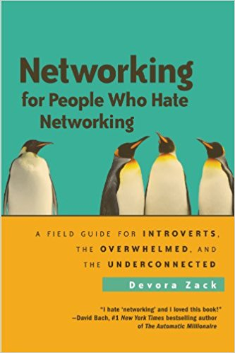
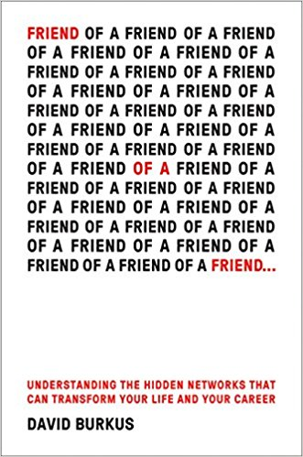
Recommended Reading
Publishing date: May 1, 2018

Slide 11
INFORMATIONAL INTERVIEWS ARE:
An opportunity to obtain more information, feedback and an “insider” perspective about a particular career, position or company or role within UCLA and what it takes to be successful in that field or role.
These conversations will help position you competitively for a job interview or other networking conversations with others in UCLA – or at a company
A chance to make a strong impression to an industry or UCLA contact or colleague that might lead to potential referrals or opportunities in the future.
A crucial and highly effective way to expand your professional network by significantly increasing the number of professional contacts whom you know and who know you – who you have made a great impression with
Most importantly: An opportunity to make new friend!

Slide 12
INFORMATIONAL INTERVIEWS ARE NOT:
The time to ask for a job. If you start the conversation by asking your contact if they know of any job opportunities, you may immediately lose their interest.
A job interview. Don’t push too hard on selling your individual strengths, or why you would be a great fit with their department.
This isn’t the time for the hard sell; however, you can strategically talk about your key strengths, experiences if asked or if opportunity arises.

Slide 13
THE LIKEABILITY FACTOR – MAKING A GREAT IMPRESSION
What is likeability so important?
Show a genuine interest in the person you are speaking with
Smile!
Ask compelling questions about them, and have a sense of humor about yourself
Be “real” (i.e., don’t pretend to be one way just to impress them. It will backfire.) The more “likeable” a person is, the more willing a contact is interested in helping a person.

Slide 14
What are your networking roadblocks?

Slide 15
Questions?

Slide 16
Thank you to AMG, Paris McDonald and
Dianne Fuller – and thanks to you!

